Slide 1
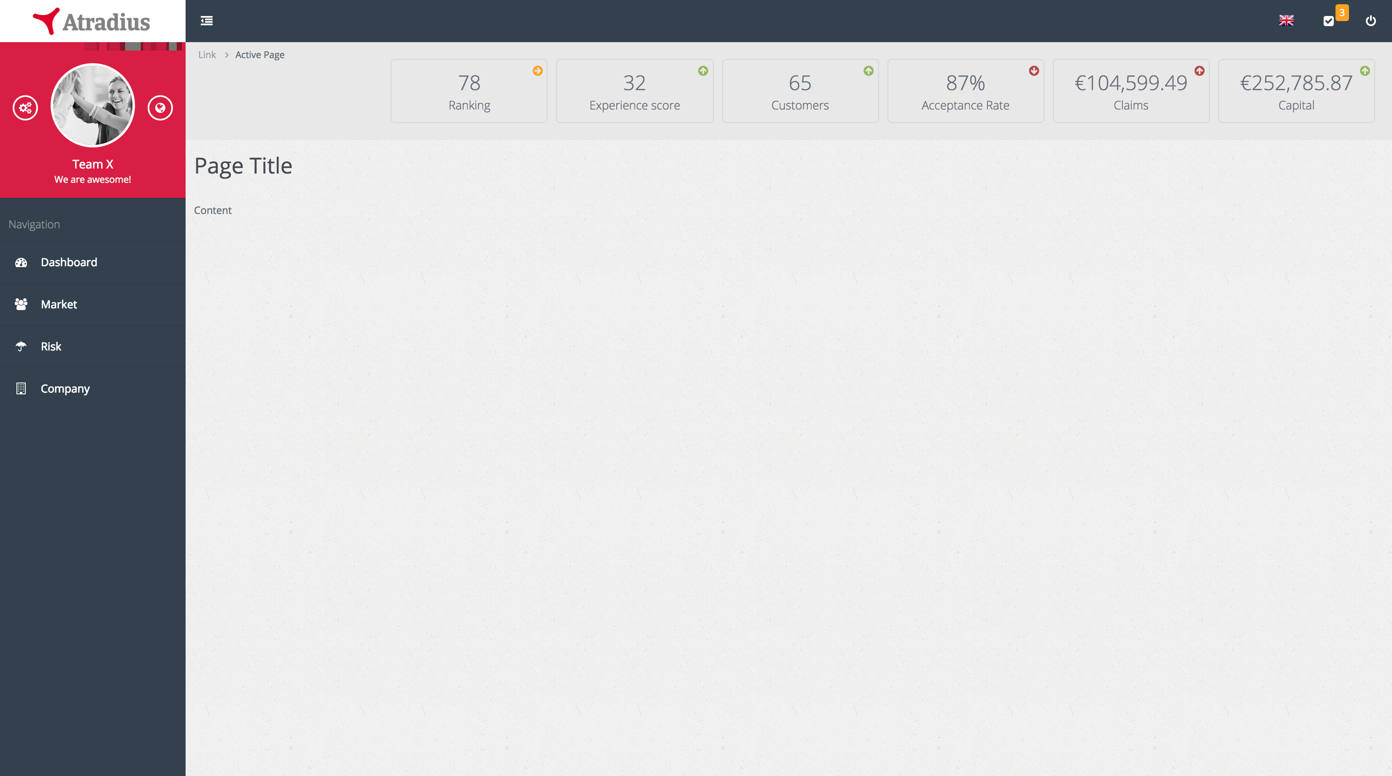
Atradius Experience
DRAFT
Site screen

Slide 2
Contents
Overview
Sidebar
Navbar
Mini dashboard
Alerts
Misc

Slide 3
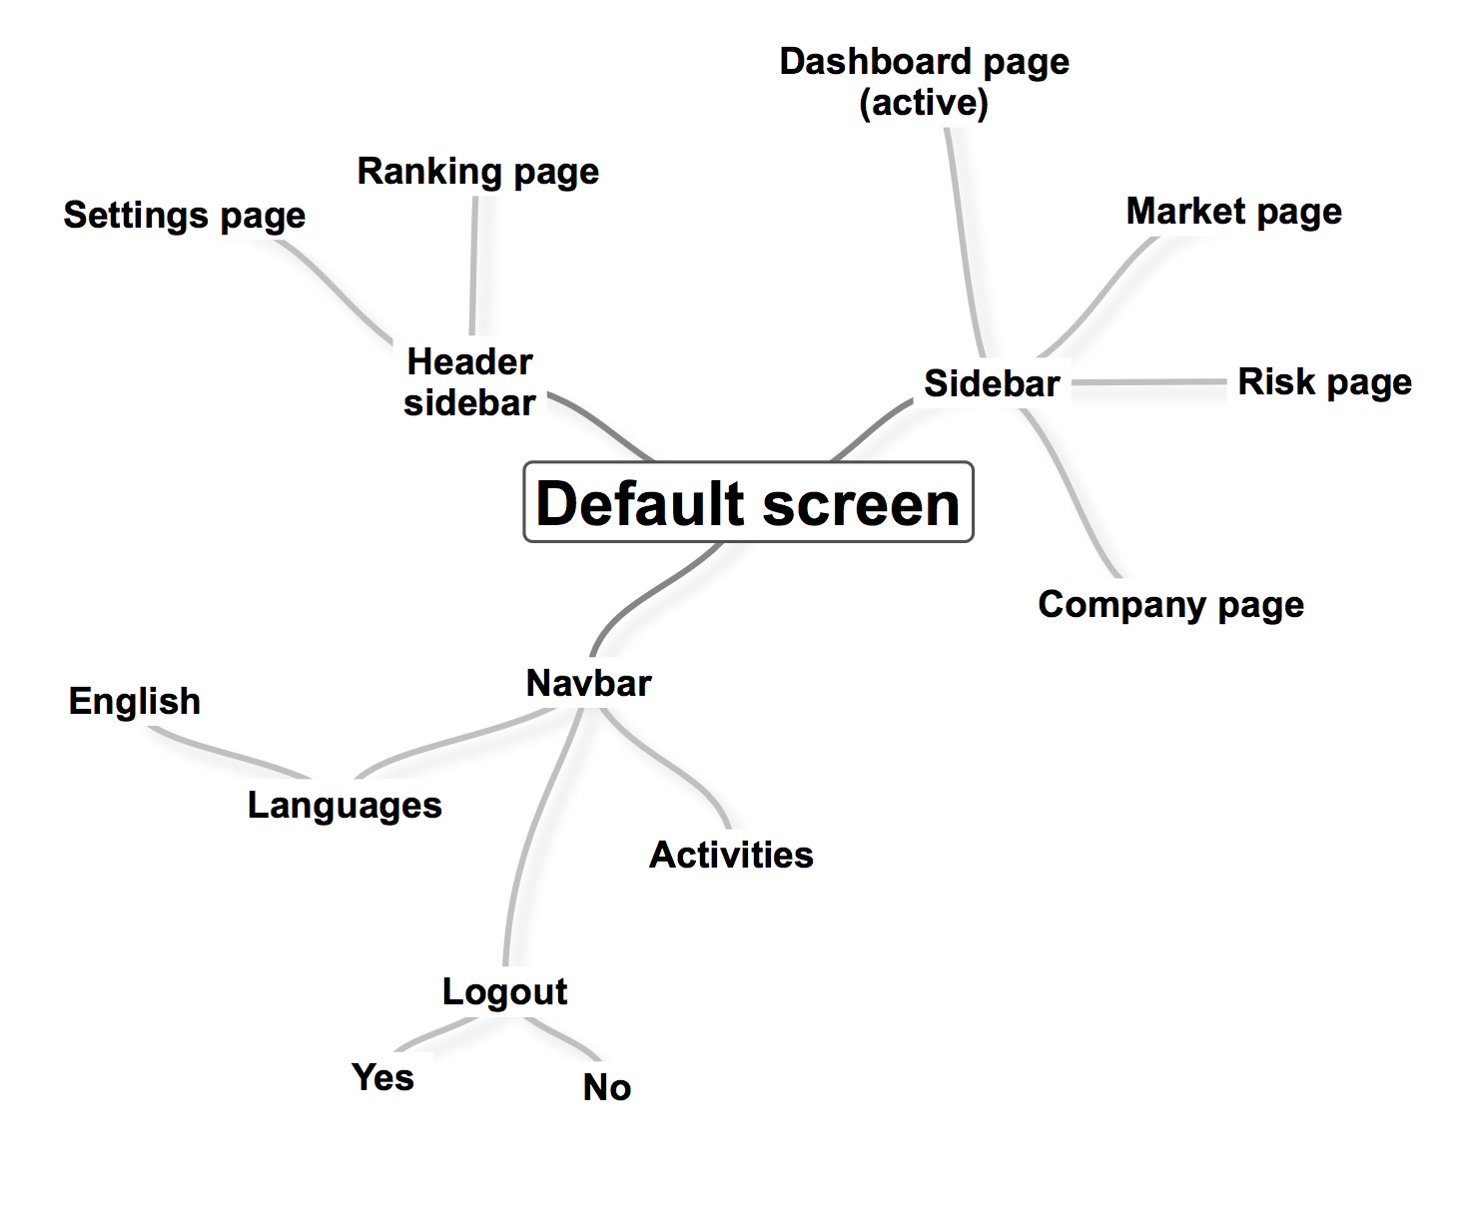
Overview – Default screen: User options

Slide 4
Overview – Default slide

Slide 5
Overview – Default slide
A1
A5
A6
A7
A2
A3
A4

Slide 6
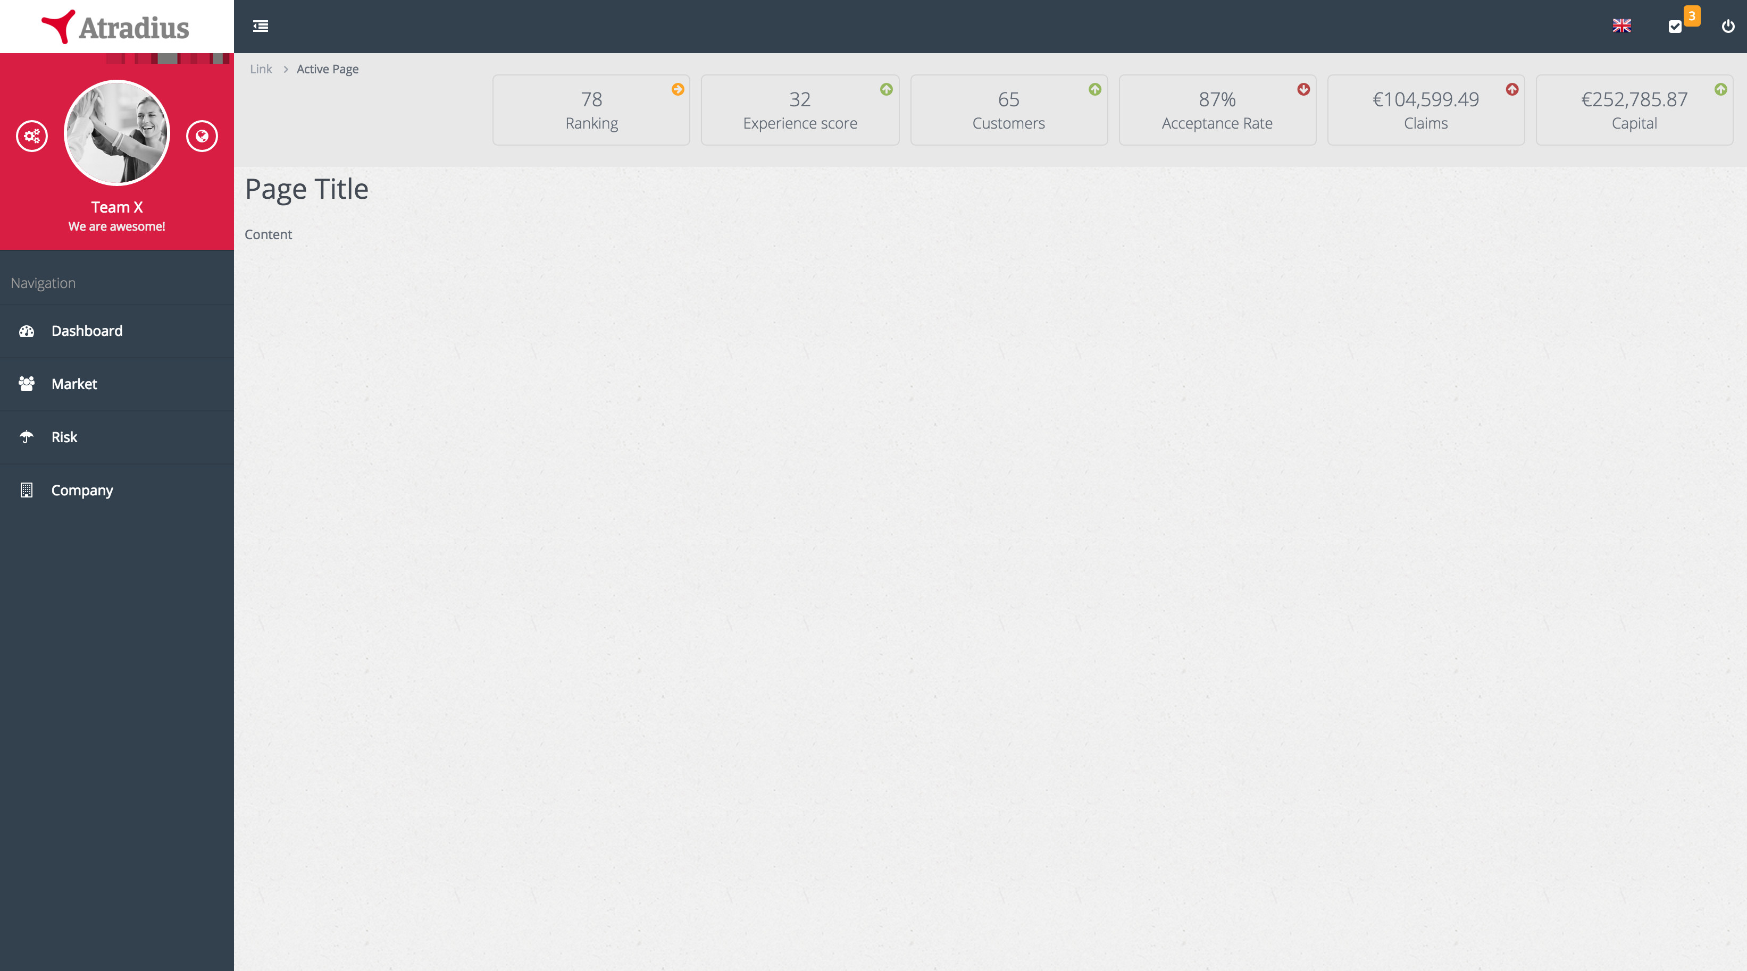
Overview – Default slide: areas
SIDEBAR
NAVBAR
MINI DASHBOARD
STACKED NOTIFICATION
AREA
BODY

Slide 7
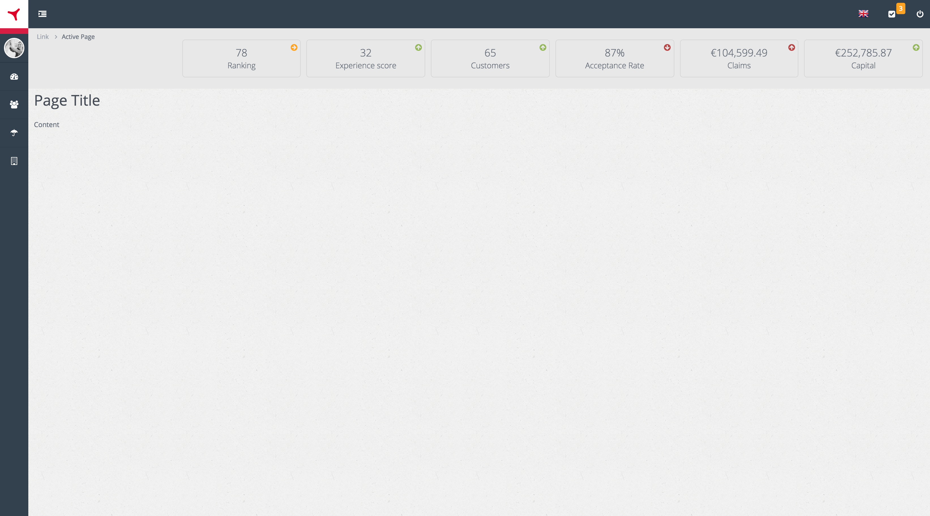
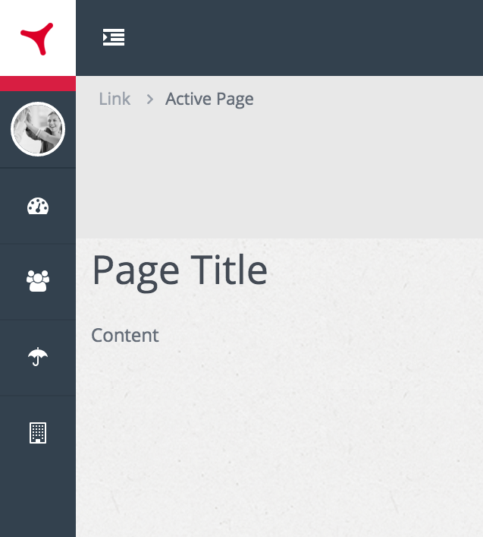
Sidebar – Collapsable
A1
A1
Collapses sidebar upon click
Automatically resizing of logo, avatar and sidebar menu links
The rest of the page adapts (responsive)
A1

Slide 8
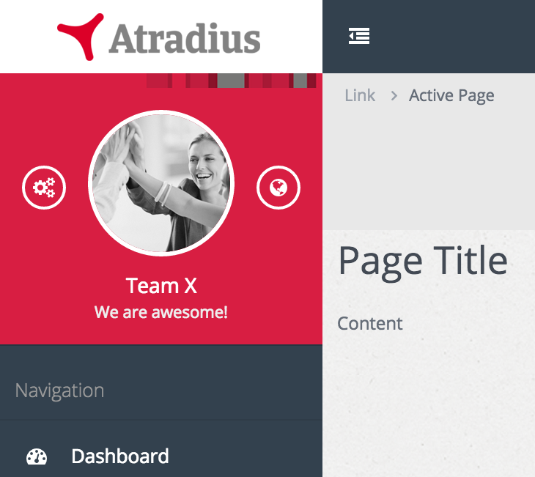
Sidebar – Sidebar header
A2
A3
A4
A2
Links to settings page
A3
Avatar
Opens desktop window to select an image to upload
A4
Links to ranking page
A2
A3
A4

Slide 9
Sidebar – Front-end
ID# | Dynamic/Static | Element Name | Element Type | Default state | Action | Response/ Notes
Block A – short description
A1 | Dynamic | collapseSidebar | Hyperlink | Disabled | Collapse entire sidebar towards the left with CSS/Javascript on the front-end | Images like logo and avatar need to be made smaller as the sidebar will remain visible
A2 | Dynamic | /settings | Hyperlink | Disabled | Loads ‘settings’ content | None
A3 | Dynamic | uploadAvatar | Hyperlink | Disabled | Opens OS selection window | After image selection, the image is displayed immediately in the avatar position after upload
A4 | Dynamic | /ranking | Hyperlink | Disabled | Loads ‘ranking’ content | None

Slide 10
Sidebar – Backend
ID# | Event | Business logic
A1 | OnClick | None
A2 | OnClick | Ui-router redraws BODY with the ‘settings’ content
A3 | OnClick | Open OS file selection window, after submit upload the image to the server and store it in the ‘team’ collection. Then load it in the avatar placeholder.
A4 | OnClick | Ui-router redraws BODY with the ‘ranking’ content

Slide 11
Sidebar – Backend validation and errors
ID# | Scenario | Validation | Notify user type | Alert (Error) text
A3 | If user attempts to upload a non-image file | Check if non-image file is selected for upload | Error | The selected file is not an image. Please select an image file like JPG or PNG.
A3 | If user attempts to upload a file with a greater than 500px by 500px dimension | Check if image has bigger dimensions than 500px | Error | Your image is to big. Please make your image smaller so that we can upload the file to your profile.
A3 | If user attempts to upload a file larger than 500kb | Check if image is below 500kb in size | Error | Your image is too heavy. Please make sure the image size is below 500kb. Perhaps you can make your image smaller.
A3 | When system has successfully replaced the previous (default) avatar with the newly uploaded image | When image is successfully uploaded and replaced | Success | You successfully uploaded your team avatar!

Slide 12
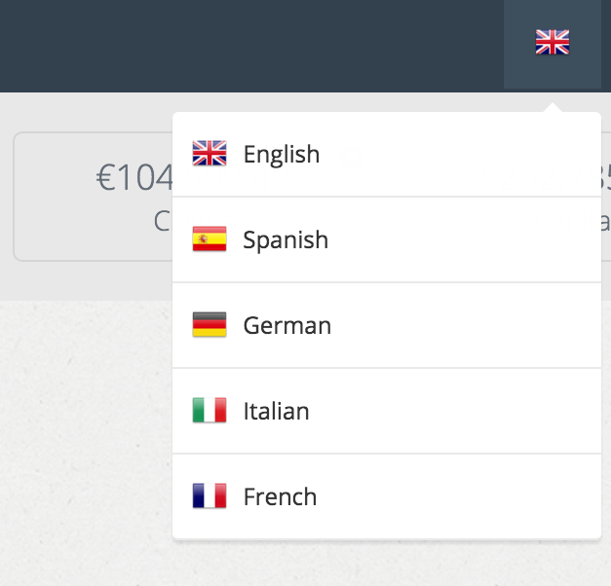
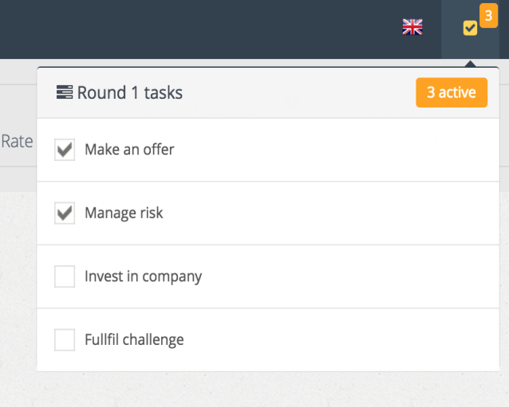
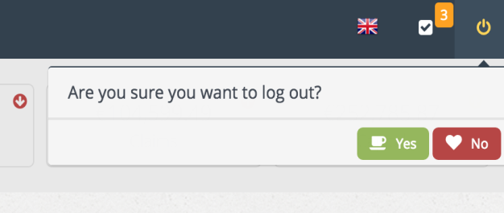
Navbar – dropdown menu
A5
A6
A7
A5
A6
A7
A6
Activity list with icon notification on outstanding activities
A7
Opens logout dialog
A5
Language selection

Slide 13
Navbar – Frontend
ID# | Dynamic/Static | Element Name | Element Type | Default state | Action | Response/ Notes
Block A – short description
A5 | Dynamic | languageSettings | Hyperlink | Disabled | Navbar dropdown opens languages dialog | Selected language is not in the dropdown. All content need to be ready for localization
A6 | Dynamic | activityList | Hyperlink | Disabled | Navbar dropdown opens activity list | User can not interact with the items in the activity list. The list is a fixed set of actions that the user have to accomplish in the respective round. Each round the activity list resets Has icon notification, showing the amount of outstanding activities left undone (unchecked)
A7 | Dynamic | logoutDecision | Hyperlink | Disabled | Navbar dropdown opens logout dialog | The user can select ‘yes’ (to log user out of its session) or ‘no’ to cancel the dialog. If ‘no’ is selected, dialog box gets disabled (disappears)

Slide 14
Navbar – Backend
ID# | Event | Business logic
A5 | OnClick & ‘language selection’ | Switch localization to the user’s selection which changes the entire text to the specific language and updates the respective page (replacing previous text with new text)
A6 | OnClick & ‘activity list dropdown’ | Dropdown the activity list with all activities displayed for each round. The activities that are outstanding are determined by whether certain actions haven’t happened yet. With every new round, set below elements to false (unchecked) and then set it to true every time an activity takes place (so it will be left as checked). Manage risk -> check if team has set a risk strategy on the Risk Page Make an offer -> check if team has made an offer on the Market Page Invest in company -> check if team has made an investment on the Company Page Fulfil challenge -> check if team has accomplished this round’s challenge (TBD)
A7 | OnClick & ‘yes’ | Log user out of its session

Slide 15
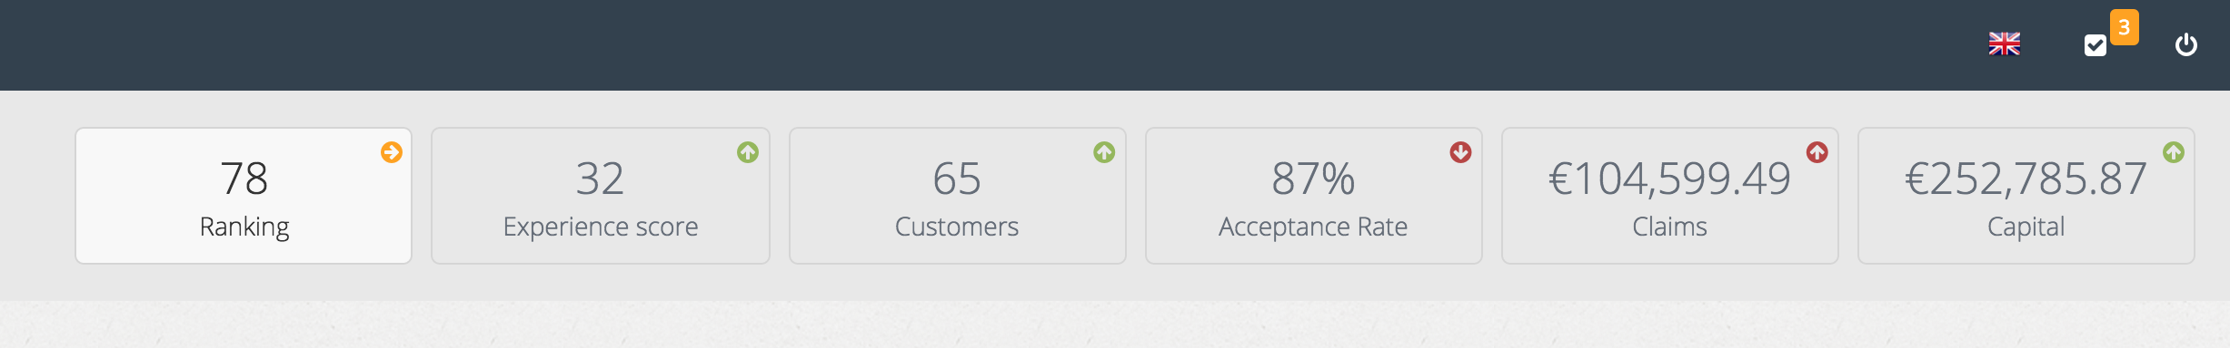
Replace ‘Acceptance rate’ with ‘Premium’
Mini dashboard
MINI DASHBOARD
An overview of the game the key game indicators to track team performance
Doesn’t do much except when you hover over it, it lights up
An ‘equal’, ‘up’ and ‘down’ arrow shows how the team performance based on previous round results
A8
A9
A10
A11
A12
A13

Slide 16
todo
Mini dashboard – Backend
ID# | Event | Business logic
A8 | Load ranking number | After every round’s recalculation, teams need to be assigned a rank in comparison with other teams based on how much capital they own (i.e. team with highest capital is ranked 1). On page load – except login & error pages – current & previous round’s team rank is retrieved to display the rank and whether to display and up, right or down coloured icon.
A9
A10

Slide 17
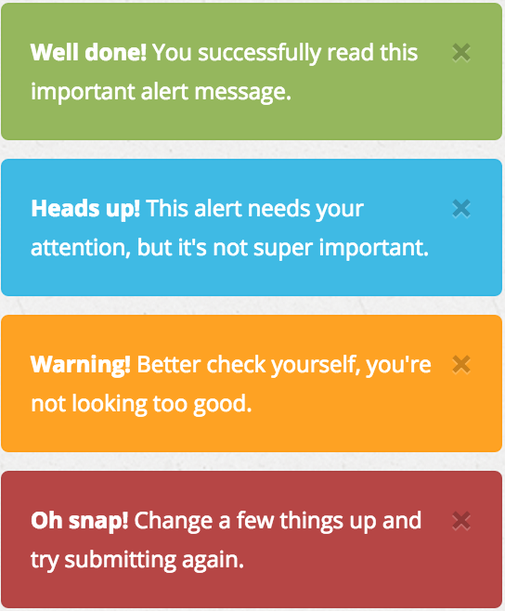
Alerts
Alert
Alert box pops up to notify user about a system message
Made with ‘toastr’ package

Slide 18
Alerts – Frontend
ID# | Dynamic/Static | Element Name | Element Type | Default state | Action | Response/ Notes
Block A – short description
Alert | Dynamic | notifyer | Div tag | Disabled | Only pops up when the system pushes a message to the client (e.g. when user accomplished a specific activity) If multiple messages have been pushed from the server, then the message will stack on top of each other with the newest on top | We used ‘toastr’ package that can easily be incorporated when certain conditions apply (front-end rendering comes included). These messages need to be localized Implementation: toastr.success(‘title’, ‘msg’); toastr.info(‘title’, ‘msg’); toastr.error(‘title’, ‘msg’); Package: https://github.com/Foxandxss/angular-toastr

Slide 19
Misc
todo
A14
Breadcrumb
…
A15
A16
Title & Slogan
…
Sidebar navigation
…

